Slide 1
Federated Data Ponds for NOAA Web Services:
A Unified AI-Assisted API Solution
Streamlining Data Access for Diverse Personas

Slide 2
Agenda
  Goal: Establish a federated system of data ponds for NOAA web services
  Analysis: Review of NOAA endpoints and data pond design
  Recommendation: Propose a federated API with AI layering across ponds
  Output: Deliver a unified API for personalized data access
  Example (Use Case): Demonstrate practical applications
  Approach #1 & #2: Visualize the solution with updated diagrams

Slide 3
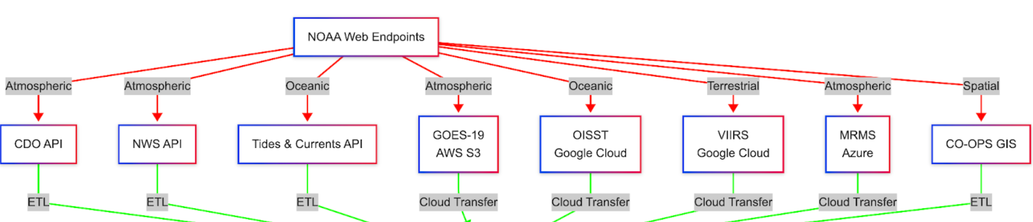
Goal: A Federated System of Data Ponds
  Objective: Organize NOAA’s 25 web service endpoints into data ponds by data type (e.g., Atmospheric, Oceanic) to enable efficient access for 12 personas, supporting NESDIS Storefront goals (REQ-NS-129, REQ-NS-156)
  Why Data Ponds?
    Fragmented endpoints (e.g., CDO API, GOES-19, SARSAT) with inconsistent formats (JSON, NetCDF, GeoJSON)
    Single data lake is complex; ponds offer modularity and performance
    Diverse persona needs: Dr. Samuel Ortiz (climate modeling), Alison Wright (media visuals), Claire Jansen (emergency planning)
  Solution: Federated data ponds with a unified API, aligning with FAIR principles (NAO 212-15B) and human-centered design (REQ-NS-XXX)

Slide 4
Analysis: NOAA Endpoints and Data Pond Design
  25 Endpoints (NESDIS, OSPO, NWS, NOS, NCEI, OAR):
    Atmospheric (12): CDO API, NWS API, GOES-19, MRMS, EMWIN, HURSAT, etc.
    Oceanic (4): Tides & Currents API, OISST, MPSR, Jason Series
    Terrestrial (2): VIIRS, Argos DCS
    Spatial (2): CO-OPS GIS, SARSAT
    Multi-Type (3): NCEI API, GEONETCast
    Metadata (1): Repository API
    Restricted (7, overlapping): GOES DCS, SARSAT, EMWIN, etc.
  Formats: JSON (1–10 KB), NetCDF (10 MB–1 GB), GeoJSON, BUFR, proprietary
  Traffic:
    Ingress: ~Tens TB/day (e.g., GOES-19 to Atmospheric Pond)
    Inter-Pond: ~1–10 TB/day
    Egress: 10–100 GB (Ortiz), 1–10 KB (Wright)
  Integration: Supports NCCF and APIs (REQ-NS-156, REQ-NS-203)

Slide 5
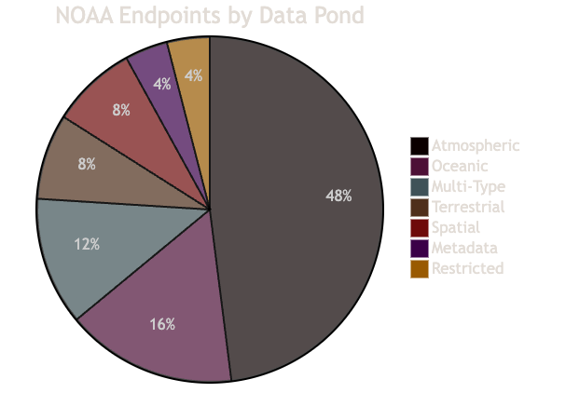
Analysis: NOAA Endpoints and Data Pond Design

Slide 6
Analysis: Challenges and Pain Points
  Poor Metadata (Ortiz, Lin):
    Inconsistent schemas (e.g., CDO vs. NCEI)
    Solution: Pond-specific metadata catalogs (REQ-NS-137)
  Complex Filtering (Lin, Myers):
    Diverse formats
    Solution: Scoped queries to ponds (REQ-NS-135)
  Licensing Ambiguity (Myers, Stone):
    Unclear commercial terms
    Solution: Pond-level access controls (REQ-NS-174)
  Format Inconsistency (Lee, Wright):
    JSON vs. NetCDF vs. GeoJSON
    Solution: Normalized JSON via API (REQ-NS-214)

Slide 7
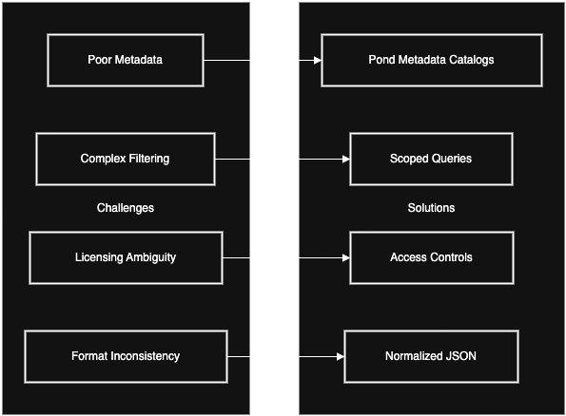
Analysis: Challenges and Pain Points

Slide 8
Recommendation: Federated Data Ponds with AI-Assisted API
  Federated Data Ponds:
    6+ ponds: Atmospheric, Oceanic, Terrestrial, Spatial, Multi-Type, Metadata, Restricted
    ETL normalizes data (e.g., JSON/NetCDF → Parquet) with metadata catalogs (REQ-NS-156)
  Unified API:
    https://api.noaa-ponds.org/v1/data queries across ponds (REQ-NS-135, REQ-NS-115)
    Example: /data?type=storm®ion=CA → Atmospheric + Oceanic
  JSON API:
    Default JSON output, options for NetCDF, GeoJSON (REQ-NS-214, REQ-NS-127)
  AI Layering:
    BERT-based NLP routes queries (e.g., “urban heat” → Oceanic + Terrestrial)
    Personalizes responses (e.g., Ortiz: NetCDF) (REQ-NS-125)
  Security: 2FA, OAuth for Restricted Pond (REQ-NS-193, REQ-NS-174)

Slide 9
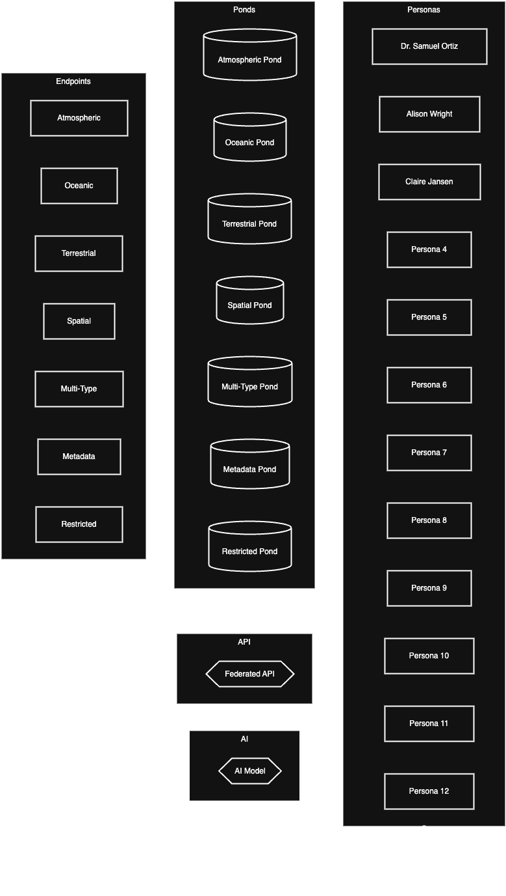
Recommendation: Federated Data
Ponds with AI-Assisted API

Slide 10
Output: Unified API with Data Personalization
  Federated API:
    Queries ponds, delivers JSON (e.g., /data?type=urban_heat) (REQ-NS-137)
    Options: NetCDF, GeoJSON, imagery (REQ-NS-214)
  Layering:
    AI routing (e.g., Jansen: Atmospheric + Oceanic)
    Personalization: Ortiz (NetCDF), Wright (GeoJSON) (REQ-NS-125)
    Cross-Pond Aggregation (e.g., Myers: GOES-19 + OISST)
  Benefits:
    Metadata resolution (REQ-NS-137)
    Simplified filtering (REQ-NS-135)
    Licensing clarity (REQ-NS-174)
  Security: OAuth for Restricted Pond (REQ-NS-103, REQ-NS-174)

Slide 11
Output: Unified API with Data Personalization
JSON snippet example
json{
"data": { "precipitation": [], "water_levels": [] },
"metadata": { "sources": ["Atmospheric Pond", "Oceanic Pond"]
}

Slide 12
Use Case: Lieutenant Colonel Jenna Blackwell
(Military Operations Planner)
  Persona Background: Lieutenant Colonel Jenna Blackwell is a military operations planner with the U.S. Air Force, specializing in real-time environmental data for mission planning and execution. She requires rapid access to NOAA’s weather and geospatial data to support operations, including disaster response and tactical missions. Her role demands high-availability data, secure access to restricted endpoints (e.g., EMWIN, SARSAT), and integration with military systems. She has NOAA public trust clearance, enabling access to sensitive datasets.
  Scenario: Lt. Col. Blackwell is tasked with planning a humanitarian aid mission in response to a Category 4 hurricane approaching the southeastern U.S. coast. The mission involves coordinating Air Force logistics, including airlifts and reconnaissance flights, to deliver supplies and assess damage. She needs real-time weather data (e.g., precipitation, wind speed), geospatial data (e.g., flood zones), and satellite imagery to ensure safe flight paths and prioritize aid distribution. The data must be accessible securely, quickly, and in formats compatible with military planning tools (e.g., JSON for real-time updates, GeoJSON for mapping).

Slide 13
Current State
Blackwell accesses NOAA’s endpoints separately: NWS API for weather forecasts, GOES-19 for satellite imagery, and CO-OPS GIS for coastal flood data.
Challenges include:
Fragmented Access: Navigating multiple endpoints (e.g., NWS API, GOES-19) is time-consuming.
Format Inconsistency: JSON (NWS API) and NetCDF (GOES-19) require manual conversion for integration.
Security: Restricted endpoints like EMWIN (emergency weather data) require separate authentication, slowing her workflow.
Metadata Gaps: Unclear data sources and update frequencies hinder decision-making under tight deadlines.

Slide 14
Proposed Solution with Federated Data Ponds
System Response:
AI Routing: A BERT-based NLP model interprets the query and routes it to relevant ponds:
  Atmospheric Pond: Pulls NWS API (JSON) and GOES-19 (NetCDF) for weather and imagery.
  Spatial Pond: Retrieves CO-OPS GIS (GeoJSON) for flood zones.
  Restricted Pond: Accesses EMWIN (real-time alerts) using her NOAA clearance via OAuth.
Data Aggregation: The API normalizes data into JSON by default, with an option for GeoJSON to support mapping tools. For example:
Personalization: The AI tailors the response to Blackwell’s needs:
Prioritizes real-time JSON for quick integration into mission planning software.
Includes metadata (e.g., source, latency) to ensure reliability for critical decisions.
Security: OAuth authentication verifies her clearance for EMWIN, ensuring compliance with security requirements (REQ-NS-174, REQ-NS-193).

Slide 15
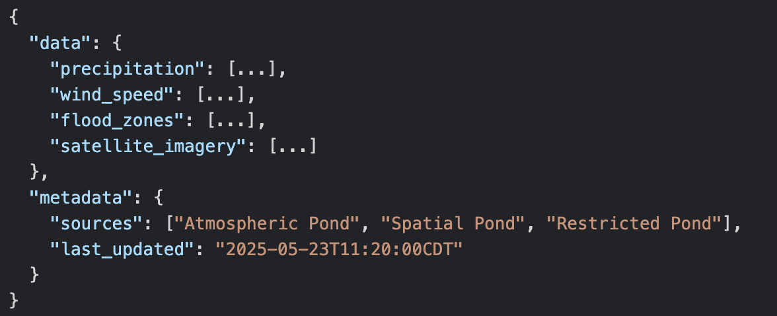
Sample JSON Request

Slide 16
Outcome
Efficiency: Blackwell accesses all necessary data through one API call, reducing planning time from hours to minutes.
Accuracy: Normalized JSON and clear metadata ensure data compatibility and reliability, enabling precise flight path planning and aid prioritization.
Security: Secure access to restricted data (EMWIN) supports mission-critical decisions without delays.
Impact: The mission successfully delivers aid to affected areas, with safe and optimized flight operations, enhancing disaster response effectiveness.

Slide 17
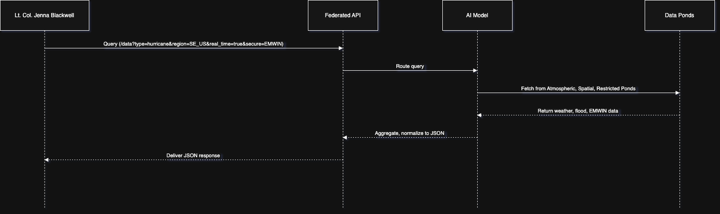
Use Case: Lieutenant Colonel Jenna Blackwell
(Military Operations Planner)

Slide 18
Approach #1: Endpoints to Data Ponds
    ETL: JSON/NetCDF → Parquet (REQ-NS-156)
    Restricted Pond: Clearance-based access (REQ-NS-174)
    Metadata catalogs for routing (REQ-NS-137)
    Traffic: ~Tens TB/day ingress

Slide 19
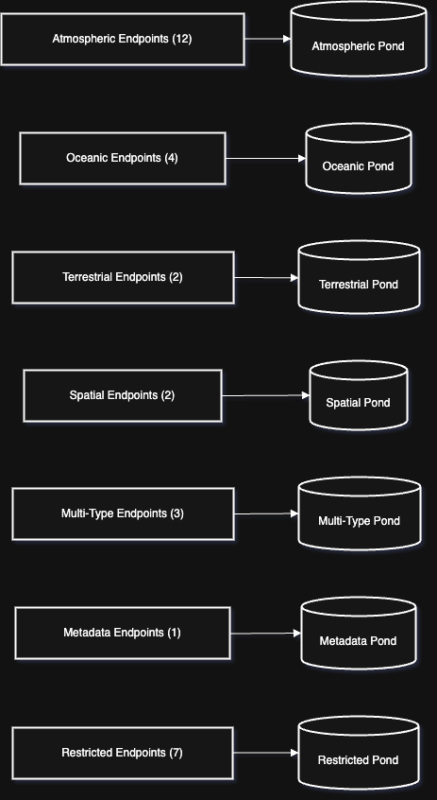
Approach #1: Endpoints to
Data Ponds

Slide 20
Approach #2: Data Ponds to Personas
    Multi-pond queries (e.g., Lin: Oceanic + Terrestrial)
    AI routing (REQ-NS-135)
    Personalized delivery (REQ-NS-125)
    Traffic: 10–100 GB (Ortiz), 1–10 KB (Wright)

Slide 21
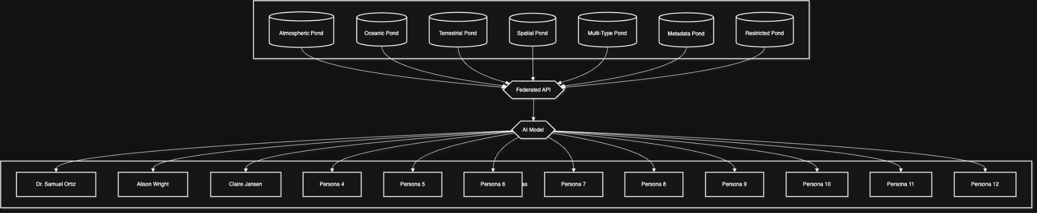
Approach #2: Data Ponds to Personas

Slide 22
Conclusion: A Scalable, Personalized Solution
  Data Ponds: Modular repositories for 25 endpoints (REQ-NS-156)
  Federated API: Unified, AI-driven access (REQ-NS-135, REQ-NS-125)
  Benefits:
    Resolves metadata/filtering/format issues
    Clarifies licensing (REQ-NS-174)
    Scales for personas
  Next Steps:
    AWS S3, Spark for ponds (or internal / standardized)
    AWS Lambda, BERT for API/AI (or custom)
    NSOF authentication for restricted endpoints (REQ-NS-174)

Slide 23
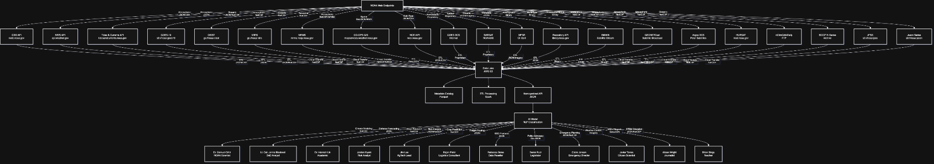
Comprehensive Overview Persona to AI to Endpoint

